Slide 1


MAIN DIRECTIONS OF INTERNATIONAL ACTIVITY
FUTURE PERSPECTIVES
S. Toraighyrov Pavlodar State University
S. Omirbayev - The Rector of S. Toraighyrov PSU, Doctor of Economics, Professor
2014

Slide 2
Membership of S.Toraighyrov Pavlodar State University in International Associations
International association on an exchange of student's and technical training (IAESTE), joining date – November, 2003
Association of educational and scientific institutions "Siberian Open University", joining date – September, 2005
CAMAN Central Asian fund of development of management, joining date – November, 2006
Association of users of a scientific and educational computer network of Kazakhstan (KazRENA), joining date – September, 2007
Academy of electric technical sciences of the Russian Federation, joining date – November, 2007
Association of Asian universities, joining date – July, 2013.
Membership in the «Magna Charta Universitatum» Bologna, Italy), joining date – September, 2009
Shanghai Cooperation Organization, joining date - 2009

Slide 3



















International Cooperation with
Foreign Higher Education Institutions
Mutual cooperation agreements of S. Toraighyrov Pavlodar State University

Slide 4
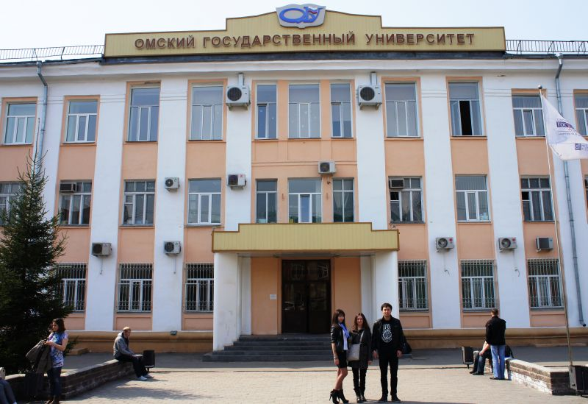
F.M. Dostoevsky Omsk State University
Kazakh language courses are carried out on the basis of F.M. Dostoevsky Omsk State University
Target audience of courses - students of F.M. Dostoevsky Omsk State University and other HIGHER EDUCATION INSTITUTIONS of Omsk region, and also everyone who wants to learn the Kazakh language.

Slide 5


International Joint Educational Programs
Training is organized
Tomsk State University (Tomsk, Russia)
6М060400 Physics (Master Program)
Agreements concluded for 2014-2015
Baltic International Academy of Psychology and Management (Riga, Latvia)
5В050300 Psychology (Bachelor Program)
Altai State University (Barnaul, Russia)
6М050300 Psychology (Master Program)
6М060800 Ecology (Master Program)
6М090200 Tourism (Master Program)
6М060700 Biology (Master Program)

Slide 6



Entering the European Higher Education Research Area
1. Assistance grant of the US Department of State «Access Micro scholarship Program», Embassy of the United States of America in Kazakhstan
2. The English Language Fellow Program, the US Department of State, Embassy of the United States of America in Kazakhstan
3. Joint project “Restoring forests and biodiversity in the forest-steppe zone of the Altai Mountains and Changay mountains in the comparative development of the livestock population in Mongolia and Kazakhstan”, Germany, Gottingen University named after Georg August

Slide 7
International Scholarship Programs
2 students of S.Toraighyrov Pavlodar State University studied abroad within IAESTE program in 2012
7 faculty members and students of S.Toraighyrov Pavlodar State University were awarded grants of the German Academic Exchange Service in 2011-2013

Slide 8
EU TEMPUS Program
The Education, Audiovisual and Culture Executive Agency (EACEA) selected 3 projects from S. Toraighyrov Pavlodar State University in 2013
Methodology for Educating Highly-Qualified Engineers at the Level of Master's Degree Studies for Development of Advanced Production Systems, coordinator Polytechnical university of Valencia
Development and Implementation of Master's Degree Programs in Food Security, Production and Marketing of Traditional Foods in Russia and Kazakhstan , coordinator Montpellier Supagro
Contributing to the Development of Education Organizations through the Development of Human Resources, coordinator T. Ryskulov Kazakh economic university

Slide 9
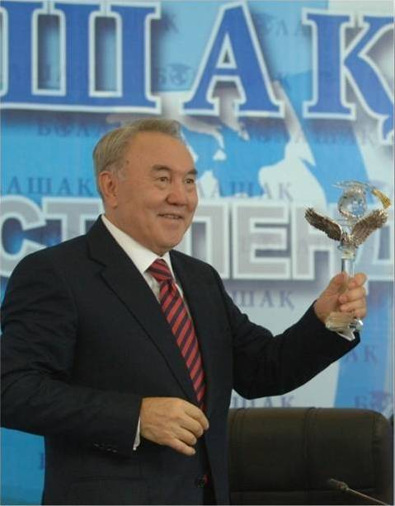





Presidential Scholarship Program «Bolashak»
In the period between 2010-2013, 29 faculty members and students were awarded Bolashak scholarship
2010-2011
2
2011-2012
6
2012-2013
21

Slide 10





















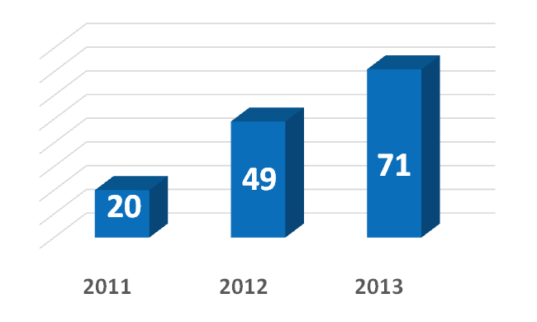
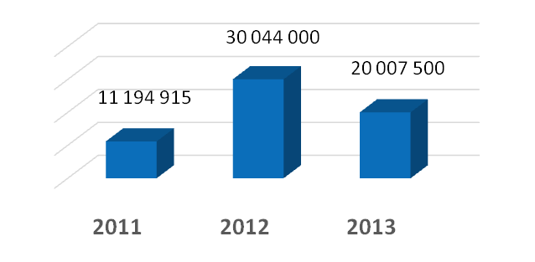
External Academic Mobility
Students
The Ministry of Education and Science of the Republic of Kazakhstan has funded the Academic Mobility Program since 2011
Funding of academic mobility
tenge
Russia
Lithuania
USA
tenge
tenge
Latvia
Poland
Italy
Czech Republic
Germany
Malta
Austria
China

Slide 11










International Students
96 international students studied in S. Toraighyrov Pavlodar State University in 2012-2013

Slide 12







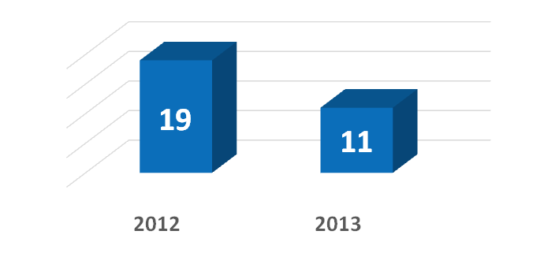
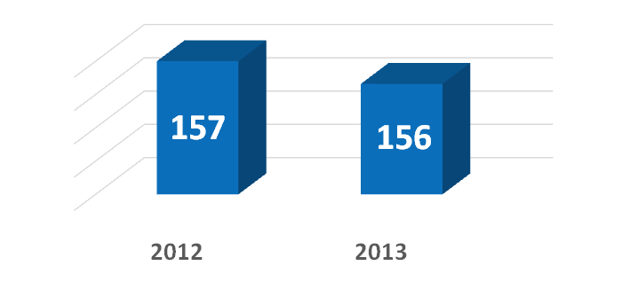
Research Internships of Postgraduate Students Abroad
Master students
Doctoral students
Russia
Great Britain
Kyrgyzstan
Latvia
Turkey
Germany
Czech Republic
Mongolia
Korea
Austria
Lithuania
Poland
China

Slide 13
Partner Universities which have accepted
S. Toraighyrov PSU students
№ | University-Partner | Country
1 | Troy University | USA
2 | Murray State University | USA
3 | Emporia State University | USA
4 | Baltic International Academy | Latvia, Riga
5 | Baltic Psychology and Management Institute | Latvia, Riga
6 | Brandenburg Technological University | Germany
7 | Collegium Civitas | Poland
8 | Czech university of life sciences | Czech Republic
9 | Wroclaw university | Poland
10 | Institute of Chemical Technology in Prague | Czech Republic, Prague
11 | Latvia University | Latvia
12 | Tomsk Polytechnic University | Russian Federation
13 | Riga Technical university | Latvia
14 | European Humanitarian Institute | Lithuania
15 | University of Warsaw | Poland
16 | Górnośląska Wyższa Szkoła Handlowa | Czech Republic
17 | Palacky University | Czech Republic
18 | Malta University | Malta
19 | Bologna University | Italy
20 | University of Goettingen | Germany

Slide 14


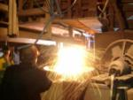

S. Toraighyrov Pavlodar State University’s Academic Programs for Partner-University Students
In 2013-2014 academic years 4 students, from M. Osimi Tajik Technical University are studying at our university on specialty “Metallurgy” within external academic mobility

Slide 15




























Foreign Scholars at S. Toraighyrov PSU
Number of scholars
PURPOSE OF THE FOREIGN SCHOLARS’ VISITS– reading lectures, carrying out information-trainings, introduction of modern technologies and programs, consulting of doctoral students
Funding
Russia
Belorussia
Germany
Spain
Latvia
Poland
Uzbekistan
Ireland
Bulgaria
United Kingdom
Ukraine
USA
Turkey
Hungary
Romania
Azerbaijan
Canada
Check
Republic
Slovenia

Slide 16
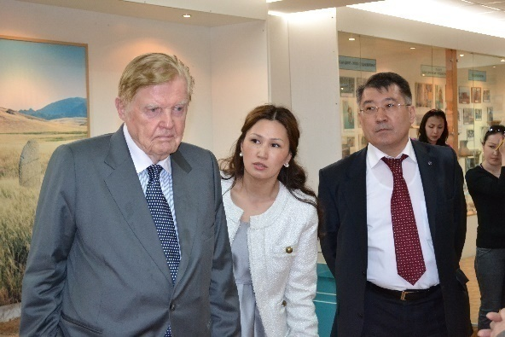
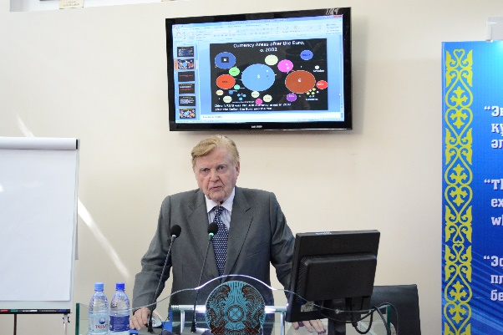
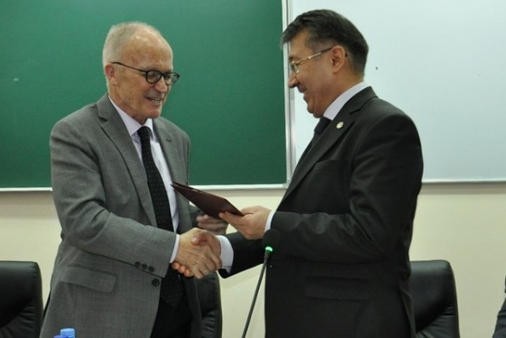
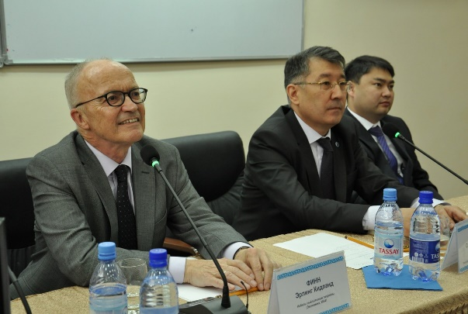
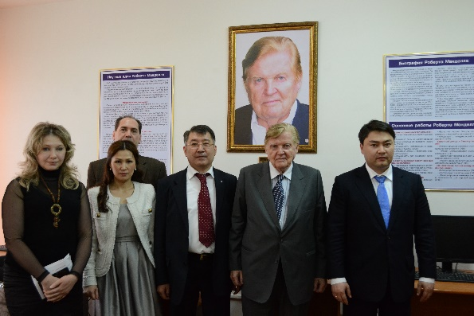
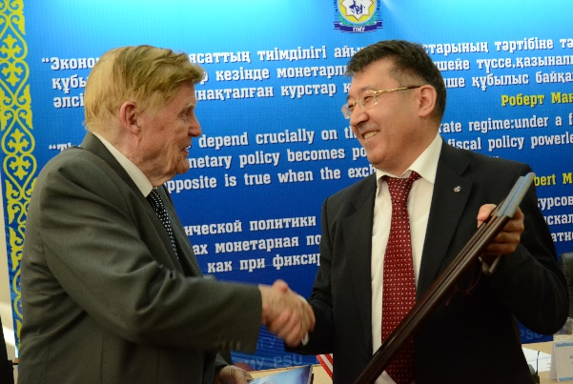
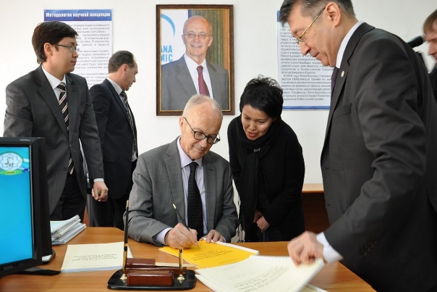
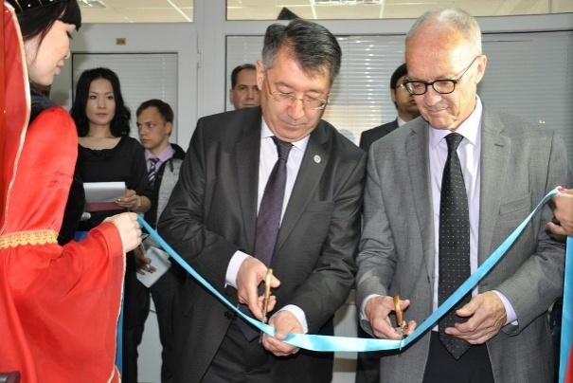
Nobel Prize Winners in S. Toraighyrov PSU
Robert Mandell
21-23 May, 2012
Fynn Kidland
May 25, 2013

Slide 17
International Cooperation Perspectives
Joining into the European University Association
Realization of joint international educational programs
Accreditation in the international agencies
Participation of the faculty members and students in the international educational programs and competitions

Slide 18
THANK YOU FOR YOUR ATTENTION!

